Slide 1
Visual Object Detection
Giri Merugu

Slide 2
My contribution
Yolov11 working mechanism
Object detection using Yolov11
Probability table and partial probability
Report (Introduction, related works, detectron and probabilities and conclusion)

Slide 3
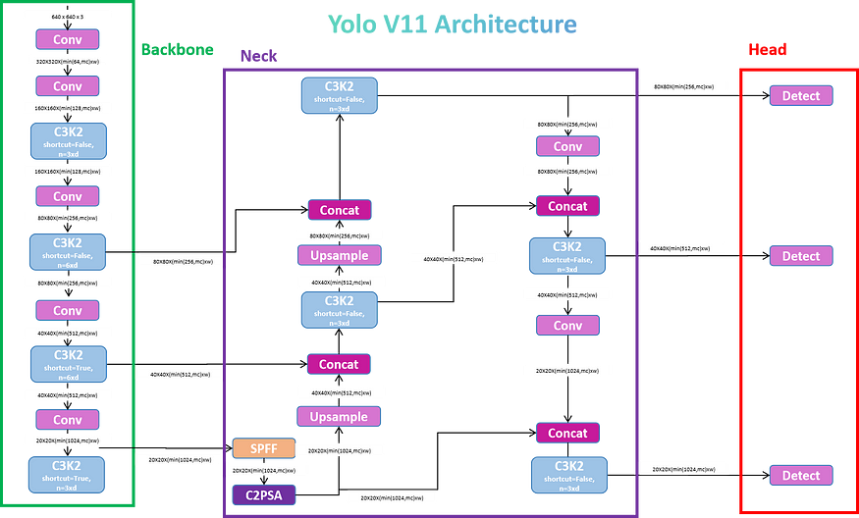

Slide 4
YOLOv11 Architecture :
Backbone: Extracts rich image features using advanced CNNs (e.g., EfficientNet) or transformers for better accuracy and efficiency.
Neck: Combines multi-scale features using FPN and PAN for enhanced detection of small and large objects.
Head: Outputs bounding boxes, class probabilities, and confidence scores with anchor-free design for simplicity.
Innovations:
Attention mechanisms (e.g., CBAM) for focus on key regions.
Improved loss functions (CIoU/DIoU) for precise localization.
Faster and refined NMS for handling crowded scenes.
Goal: Balance real-time performance with high accuracy across diverse applications.

Slide 5
Training Process
Dataset Preparation: Data formatted in COCO (images, annotations, metadata).
Augmentation: Techniques like flipping, scaling, cropping, and mosaics to enhance data diversity.
Optimization:
Loss functions (e.g., CIoU for bounding box regression, cross-entropy for classification).
Regularization methods to prevent overfitting.
Training Framework: Uses state-of-the-art libraries for faster convergence and precision.
Prediction & Performance
Prediction Flow:
Image → Backbone → Feature Maps.
Neck aggregates features → Head predicts classes, bounding boxes, and confidence scores.
Post-processed with optimized NMS.
Performance:
Speed: Achieves real-time performance (>30 FPS on GPUs).
Accuracy: High mAP (Mean Average Precision) on COCO dataset.
Scalability: Effective across varying resolutions and object densities.

Slide 6
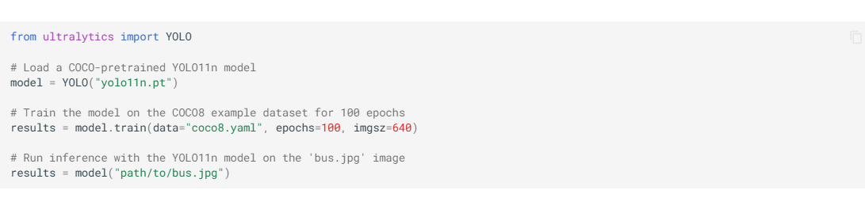
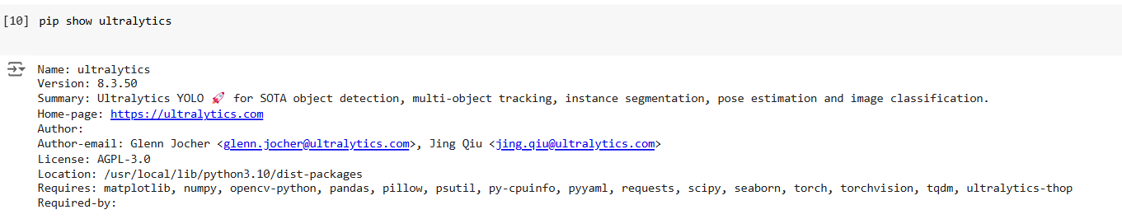
Using Yolov11 in the project

Slide 7
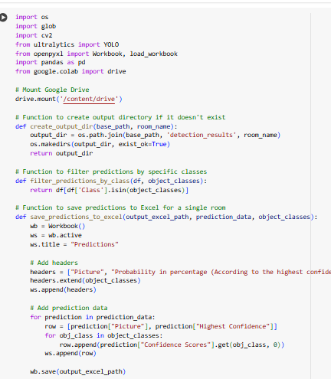

Slide 8
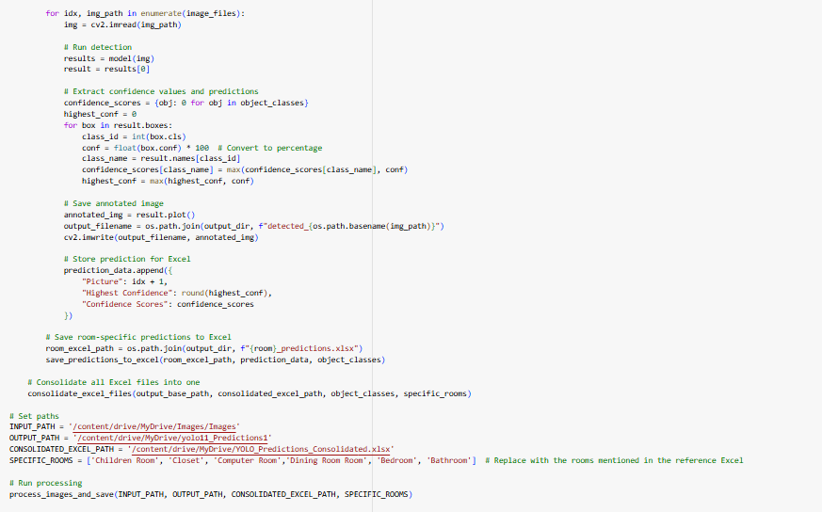
Writing the output into a Drive folder

Slide 9
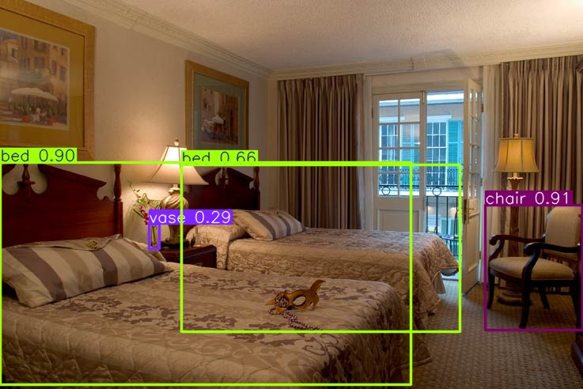

Slide 10
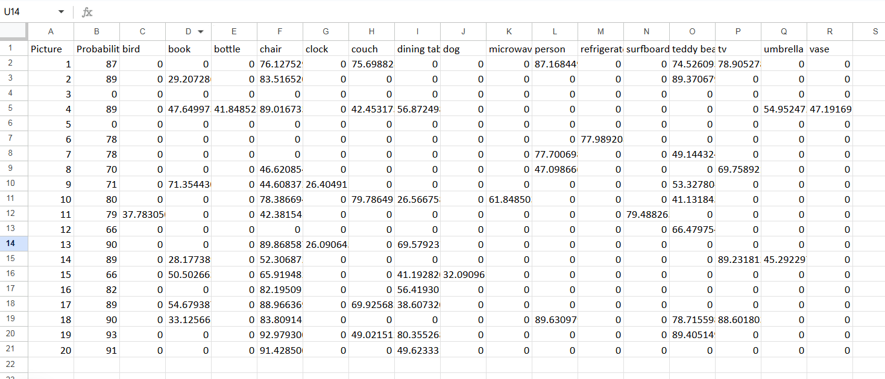
Probability

Slide 11
Some previous works
Benchmark Study of YOLO Versions
Evaluated YOLOv3 to YOLOv11 across datasets.
YOLOv11 excelled in detecting small and rotated objects with higher accuracy and efficiency.
Architectural Innovations
Features like C3k2 block and SPPF enhanced feature extraction and scalability.
Improved both accuracy and computational performance.
YOLOv11 vs YOLOv8
YOLOv11 achieved better processing power, FPS, and model efficiency.
Suitable for real-time applications with complex environments.
Agricultural Applications
Outperformed earlier YOLO models in detecting and counting objects like fruitlets.
Demonstrated robustness in challenging environments like orchards.
Object Segmentation
Showcased high accuracy in object segmentation tasks compared to other algorithms.
Efficient for real-world scenarios like urban planning and agriculture.

Slide 12
Conclusions from our experiment
YOLOv11 offers notable improvements in accuracy and efficiency, making it a leader in real-time object detection, particularly for small and rotated objects.
The model performs exceptionally well across a variety of environments, such as agriculture and crowded spaces, making it suitable for a wide range of use cases that demand both speed and precision.
Despite its advancements, YOLOv11 could be further optimized to handle complex scenarios, such as detecting heavily occluded objects and reducing computational demands, ensuring even better performance in challenging situations.

Slide 13
Thank you
Giri Merugu
Gmeru2@unh.newhaven.edu

